Slide 1
IRELAND IN CONFLICT 1909 - 1922
Test your knowledge of who’s who in the Ireland in Conflict
topic with the following slideshow
As the images of historical personalities from the topic appear,
try to work out who they are and what view they held over Ireland’s future.
REMEMBER
Home Rule = limited government/self-rule for Ireland still linked to British Crown
(perhaps with Northern Ireland still part of United Kingdom)
Nationalist= the whole of Ireland having self-government (including North)
Republican= Ireland being independent and totally self-governing (no link to British
Crown)
Socialist= workers/people governing Ireland
Click here to begin

Slide 2
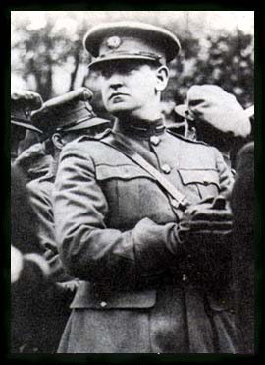
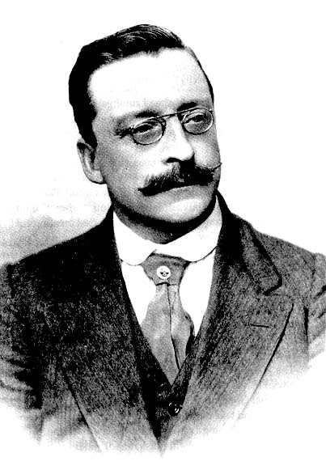
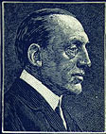
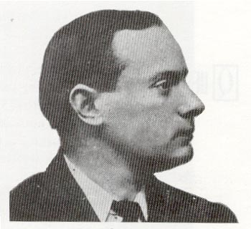
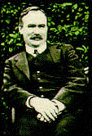
Edward CARSON
Leader of Ulster Unionist Council
UNIONIST
Arthur GRIFFITH
Founder of Sinn Fein
REPUBLICAN
Michael COLLINS
Leader of IRA forces and IRB
REPUBLICAN
Patrick PEARSE
IRB member and leader of
Easter Rising
REPUBLICAN
David LLOYD GEORGE
British Prime Minister 1916 - 1922
James CONNOLLY
Founder of Irish Citizens Army
SOCIALIST
Click here to move to the next slide

Slide 3
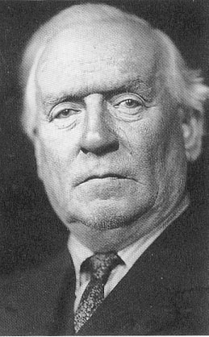
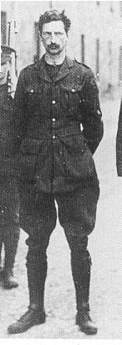
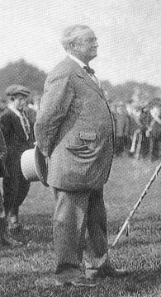
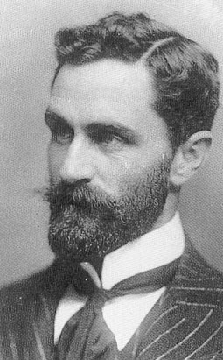
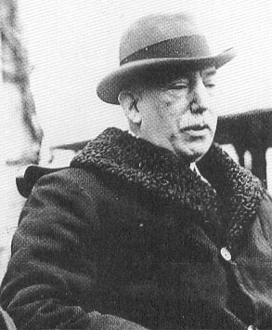
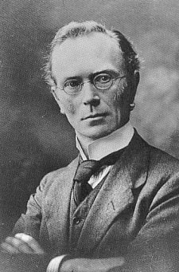
John REDMOND
Leader of Irish Nationalist Party
NATIONALIST
Eammon DE VALERA
Leader of Sinn Fein
REPUBLICAN
Herbert ASQUITH
British Prime Minister
Eoin MAC NEILL
Leader of Irish Volunteer Force
NATIONALIST
James CRAIG
Deputy Leader of Ulster Unionist Party
UNIONIST
Roger CASEMENT
Member of IRB
REPUBLICAN
Click here to move to the next slide

Slide 4
MY BUDGET WAS REJECTED BY THE HOUSE OF LORDS

Slide 5
THE FOOLS, THE FOOLS, THE FOOLS!

Slide 6
HOME RULE? OVER MY DEAD BODY!

Slide 7
MY GOODNESS, I HATE SUBMARINES

Slide 8
THE SOCIALIST REVOLUTION WILL SOLVE IRELAND’S PROBLEMS

Slide 9
WELL BOYO, YOU WILL HAVE TO SPLIT IRELAND

Slide 10
WE CANNOT AFFORD YOU GOING AROUND RIDDLING PEOPLE

Slide 11
THERE IS NOTHING WRONG WITH A STIFF WHISKEY

Slide 12
WE WILL DO A DEAL WITH YOU MR ASQUITH

Slide 13
I DID NOT HAVE A HAPPY EASTER THEY DID NOT TELL ME THE TRUTH

Slide 14
NOT SHOT IN 1916

Slide 15
HIMSELF STARTED IT

Slide 16
This powerpoint was kindly donated to www.worldofteaching.com
http://www.worldofteaching.com is home to over a thousand powerpoints submitted by teachers. This is a completely free site and requires no registration. Please visit and I hope it will help in your teaching.

